Slide 1
___ ___ ___ ___ ___ ___ ___ ___ ___ ___
___ ___ ___ ___ ___ ___ ___ ! ___ ___ ___
___ ___ ___ ___
___ ___ ___ ___ ___ ___ ___
1.
2.
3.
-(x-4) -1 1 15/8
(x-5) 1 3 -10 15/8 1 (x+4)/(x-2)
-4 1/2 0 1 1 8/x -10 3(x-5) 1 (x-2)/x
Can you figure out my favorite tv show as a kid? Go through the scavenger hunt in order to earn clues to help figure out the riddle. In order to receive full credit, you must SHOW ALL YOUR WORK! Have fun and good luck!
(x-5) -4 3 12/5 1/2 0 (x-2)/x 12/5 8/x 0
Rational Scavenger Hunt
Go to a station, solve the question, then check your answer! It’s as easy as pi ☺

Slide 2
4.
5.
6.
7.
8.
9.

Slide 3
10.
11.
12.
13.
14.
15.

Slide 4
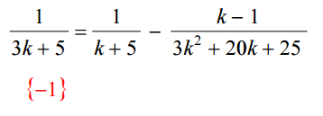
1. Solve the following:

Slide 5
9. Find the horizontal asymptote, explain how you know the answer:

Slide 6
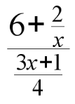
13. Simplify the following:

Slide 7
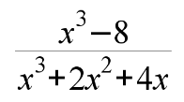
6. Simplify the following:

Slide 8
15. Solve the following:

Slide 9
14. Marcie can wallpaper a bathroom in 3 hr. Bailey can wallpaper the same bathroom in 5 hr. How long would it take them if they worked together?:

Slide 10
8. Simplify the following:

Slide 11
2. Find the vertical asymptote:

Slide 12
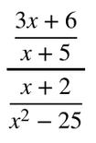
10. Simplify the following:

Slide 13
4. Justin can install a new roof in 4 days. Ben can install the same size roof in 6 days. How long will it take them to install a roof if they work together?:

Slide 14
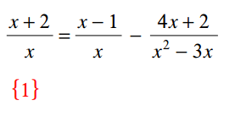
7. Solve the following:

Slide 15
12. Find the hole:

Slide 16
3. Simplify the following:

Slide 17
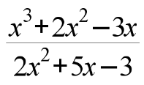
5. Find a value that is NOT included in the domain:

Slide 18
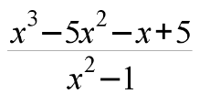
11. Simplify the following:

